Slide 1

Drug Toxicity Prediction from Molecular Descriptors
Ian Delgadillo Bonequi,
Manoj Kumar Ravi Kumar,
Rohith Ambarish,
Mohammed Faiyak Zaman,
Joshua Markworth

Slide 2

Project Overview
The Goal
To predict whether a drug is likely to cause Drug-Induced Autoimmunity (DIA) using machine learning models trained on molecular descriptors. This support early-stage toxicity prediction and improves safety assessment
The Prediction
Target Variable: Binary Classification
1: DIA-positive (Toxic)
0: DIA-negative (Non-Toxic)

Slide 3

Data Source & Origin
UCI Machine Learning Repository
Dataset Name: Drug-Induced Autoimmunity Prediction
Data Representation
Features were generated using RDKit, an open-source cheminformatics library. The data contains numerical molecular descriptors describing:
Structural characteristics
Physicochemical properties
SMILES strings (compact chemical structure)

Slide 4
Dataset Statistics
Task Type: Supervised Binary Classification
477
Training Records
120
Test Records
195
Attributes

Slide 5
Attribute Details
Numerical Predictors
195 fully numerical descriptors generated by RDKit.
Categorical Potential
Numerical variables that exhibited values of only 0 or 1 across the entire dataset were treated as categorical features, leveraging their potential as binary indicators
SMILES Expansion
We expanded the feature set by converting SMILES strings into MACCS Key Fingerprints (binary vectors) to capture substructures. This process added 166 new binary features to the dataset.

Slide 6
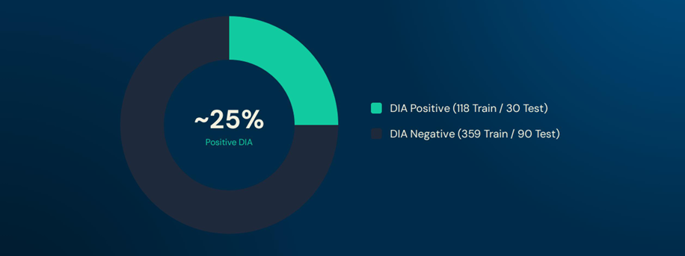
Data Quality & Class Balance
Missing Values: 0 (100% Clean)
Observation: The dataset is imbalanced reflecting real-world toxicity rarity. This necessitates specific handling techniques like class weighting.

Slide 7
Tools & Methods Overview
</>Environment & Libraries
Platform: Google Colab
Language: Python
Core Libs: Scikit-learn (Modeling), RDKit (Features), NumPy/Pandas (Data)
Modeling Approach
Primary: Logistic Regression with CV + L1 Regularization (for feature selection).
Preprocessing: One-Class SVM used for outlier removal.
Comparison: Benchmarked against SVM, Random Forest, XGBoost, and Ensembles.

Slide 8
Drug-Induced Autoimmunity
Immune system attacks healthy tissue
Most notably drug-induced lupus
Highly variable; imbalanced data
DIA prediction helps to develop safe drugs
Target variable of dataset
Labelled toxic vs non-toxic
Machine learning-based predictive toxicology

Slide 9
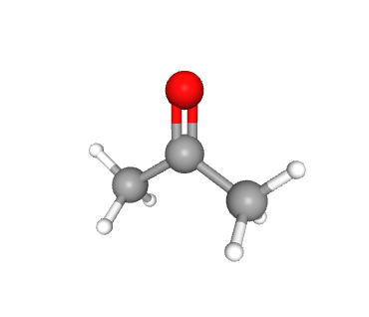
SMILES: Simplified Molecular Input Line Entry System
Chemical codes as character string
Element notation: C, N, O
Atomic number notation: [#7]
Bond types
CC, C=C, C#C
Aromaticity
Chirality
Acetone:
CC(=O)C

Slide 10
MACCS Fingerprints
166-keys as binary values
Chemically significant indicators
Derived from SMILES code using RDKit Package
Step | Python
SMILES -> RDKit molecule object | mol = Chem.MolFromSmiles(smiles)
Molecule -> MACCS key bitvector | maccs_fp = MACCSkeys.GenMACCSKeys(mol)
Bitvector -> Array | fp_array = np.array(list(maccs_fp.ToBitString())).astype(int)

Slide 11
MACCS Fingerprints
MACCS 66:
DESCRIPTION:
Two of four carbons are quaternary
SMILES PATTERN:
[#6]~[#6](~[#6])(~[#6])~*
MACCS 93:
DESCRIPTION:
Heteroatom with methyl group attached
SMILES PATTERN:
[!#6;!#1]~[CH3]
MACCS 154:
DESCRIPTION:
Contains Carbonyl
SMILES PATTERN:
[#6]=[#8]

Slide 12
Related Work – Brief Literature Review
Related work with respect to development of machine learning models to DIA prediction:
Recent developments include exploration of (molecular) structure-based approaches for predicting DIA toxicity in drugs which achieved predictive performance of 70% AUC (ROC AUC) this study, however, faced a similar challenge to our own study facing dataset imbalance issues with limited number of DIA-positive drugs [6].
Other efforts included development of molecular fingerprint-based predictive models which were able to achieve 76.26 % accuracy and 0.84 AUC on their dataset [7].
Additional efforts outside DIA prediction which leveraged Molecular Fingerprint-Based Machine Learning Models for prediction of chemical compound biodegradability achieved AUC above 90% for several models and found MACCS fingerprints to be the best predictors (particularly in combination with SVM) [8].
These previous works served as inspiration and motivation for the development of the models for our project.

Slide 13
Model Training and Prediction Process - Overview
Common process applied to all model(s) developed for the project:
Data pre-preprocessing pipeline
Optional outlier removal
Optional regularization (L1)
Optional usage of ONLY MACCS fingerprints
Model hyperparameter search and selection, and model probability prediction threshold tuning via CV
Model training and performance against training set from CV process
Model performance assessment against test set
Feature importance assessment
Optional feature removal and re-assessment of model performance

Slide 14
Model Training and Prediction Process -Preprocessing
Data pre-preprocessing pipeline:
Optional switch to enable/disable usage of SMILES
Conversion of SMILES to MACCS fingerprints with rdkit if enabled – this adds 166 additional categorical/binary predictors to be handled by each model
Separation of numerical and categorical variables***
Note: dataset includes only numerical vars; however, binary variables were treated as categorical
Removal of zero-variance predictors (useless for model training + simplify the model)
Encoding of categorical variables (Binary → categorical conversion)
Optional switch to perform preliminary L1 regression to filter out highly correlated features
Optional switch to perform preliminary outlier removal with OneClassSVM()
Re-standardization of data as needed
Option to use ONLY MACCS categorical vars
To assess potential model performance improvement with simplified dataset (fewer predictors = simpler model)

Slide 15
Model Training and Prediction Process –Hyperparameter Search and Tuning
Definition of parameter grid for use with GridSearchCV
Perform search for best model parameters against training set
Performance of GridSearchCV – performance metrics of best model are saved for each fold in the CV
Recall, Precision, Accuracy, ROC AUC, Precision-Recall AUC
Search for max AUC for selectable curve type (ROC/PR)
Perform K-fold cross validation on training set and find a best set of parameters to maximize a core
Scoring based on selectable ROC AUC or Precision-Recall Curve
Additional CV process immediately follows to tune the probability threshold of the selected model to maximize an arbitrary metric (F1) - use sklearn TunedThresholdClassifierCV()

Slide 16
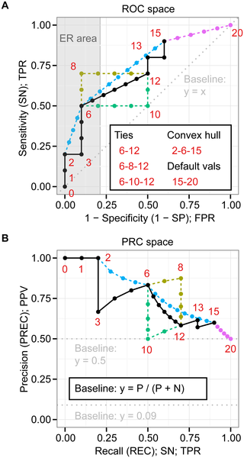
Model Training and Prediction Process – Training Performance Assessment
Model training and performance against training set from CV process:
Performance of GridSearchCV – performance metrics of best model are saved for each fold in the CV
Recall, Precision, Accuracy, ROC AUC, Precision-Recall AUC
Usage of ROC the Precision-Recall curve as scoring metrics to evaluate "best" hyperparameters and assessing model performance – options to evaluate with both Precision-Recall AUC and ROC AUC due to minority DIA-positive class records in the dataset; Precision-Recall shown to be useful and informative for imbalanced datasets [3][5].
ROC AUC can be overly optimistic due to large number of true negative in imbalanced datasets with few positive (Class 1) records – PR AUC focuses more on the (minority) positive class
This is particularly true for evaluation of early retrieval performance - PRC can show when the performance is good in the balanced but poor in the imbalanced case and AUC (PRC) scores also support this [5].
Select AUC (both ROC and PRC) as a metric for selecting best parameters to allow for a wide range of prediction probability threshold tuning to optimize a trained model for a given classification performance metric (F1, recall, precision, etc.)
These metrics serve as a baseline for subsequent evaluation of classifiers against the test dataset

Slide 17
Model Training and Prediction Process – Test Performance Assessment
Through CV process, data is fit to the training set with GridSearchCV (set parameter refit=True)
Predict test data
Assess test set prediction performance – performance metrics follow similarly to those evaluated on the training set with CV
Classification Report/Confusion Matrix
ROC AUC
Precision-Recall Curve AUC
Saving of indices of misclassified records – saved for later to search for commonalities in misclassified records

Slide 18
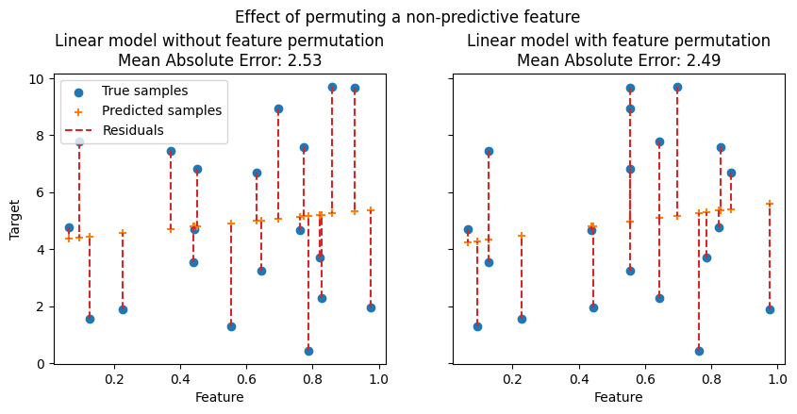
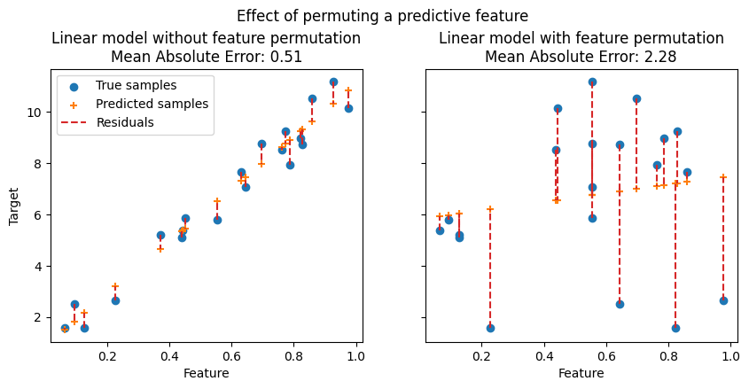
Model Training and Prediction Process – Feature Importance Assessment
Where appropriate, feature importance is evaluated by way of built-in estimator object attributes
i.e. coefficient magnitude for Logit, Gini importance for RF, etc.
Feature importance is additionally evaluated by way of permutation importance
Model agnostic
Can avoid bias that importance measures of tree-based models provide, based on the mean decrease in impurity (MDI), which can be strongly biased and favor high cardinality features over low cardinality features [1][2].
An Optional switch allows for removal of zero importance features and re-training and re-evaluation of model performance

Slide 19
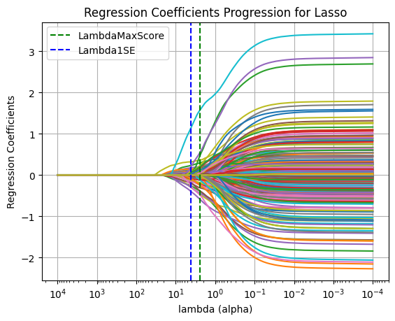
Logistic Regression
Model Architecture & Lasso Selection
1. The Strategy: Sparse Modeling
Objective: Extract meaningful signal from high-dimensional chemical data
Algorithm: Logistic Regression with L1 Lasso regularization using the SAGA solver for optimization.
2. Feature Selection Results
Tuning: Selected α ≈ 4.198 via the 1-Standard-Error Rule.
Goal: Achieve the simplest robust model to prevent overfitting.
Top Predictor (from Coefficient Magnitude): MACCS_156 (Coeff: 1.51).

Slide 20
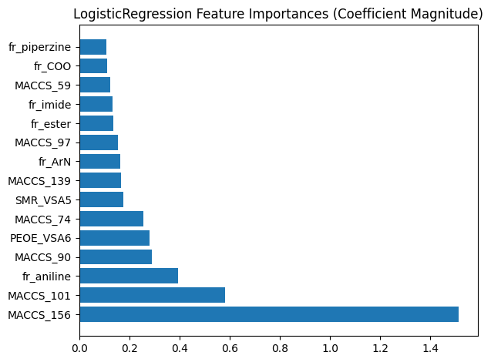
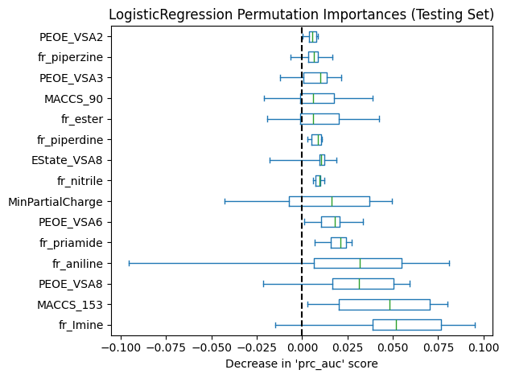
Feature Importance: Coefficients vs. Permutation
1. The Conflict:
Coefficients (Training Fit): Top Feature: MACCS_156. High risk of multicollinearity artifacts influencing the ranking.
Observation: MACCS_156 had zero permutation importance evaluated on the test set – suggests lack of generalization of the predictor beyond the training dataset
2. Permutation Importance (Generalization)
Top Feature: fr_Imine. Insight: Crucial for predicting unseen data, even if the linear coefficient is lower.
3. The Resolution
Action: Pruning "fake" predictors.
Logic: If a feature has a non-zero coefficient but negative/zero test importance, it is removed.

Slide 21
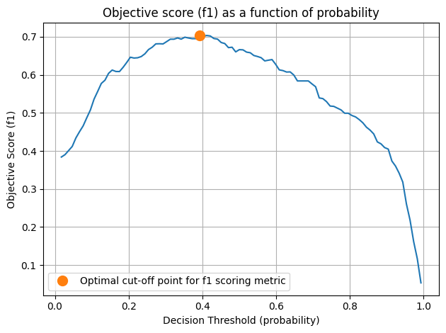
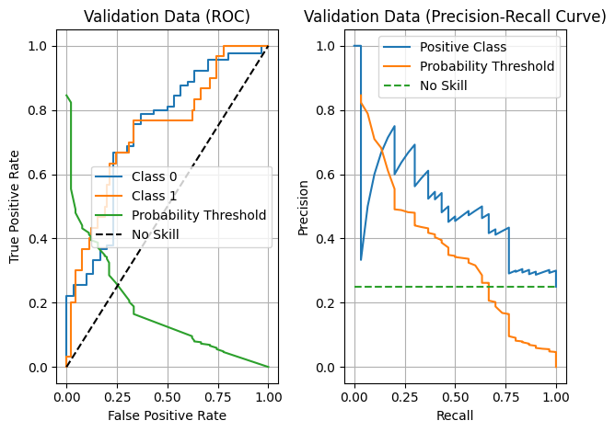
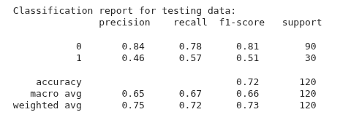
Threshold Tuning
1. The Challenge
Default Threshold (0.50) leads to high False Negatives. Risk: Missing toxic (DIA+) drugs is unacceptable.
2. The Solution
Optimization tuned for F1 & Recall. New Threshold: Lowered to ≈0.30.
3. The Impact (Validation)
Recall jumped to 83% in training. Strategy: Deliberately prioritize Safety (Recall) over Precision to ensure detection.

Slide 22
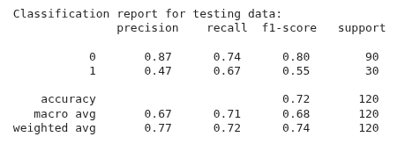
Permutation Pruning Results
The Experiment
Hypothesis: Can removing "noisy" features improve ranking?
Action: Pruned the feature set down to 61 Robust Features based on permutation scores.
The Verdict (Test Set)
Recall: 57% → 67% (Significant Safety Boost)
F1-Score: 0.51 → 0.55
PR AUC: 0.46 → 0.50
Conclusion
"Less is More"
Removing statistical noise significantly improved the model's ability to rank toxic drugs correctly on unseen data.

Slide 23
Support Vector Classifier
Model Architecture & Optimization
1. The Strategy: Non-Linear Separation
Objective: Capture complex chemical interactions that linear models (like Lasso) miss.
Kernel: RBF (Radial Basis Function).
Why? Projects data into infinite dimensions to find a separation hyperplane.
2. Grid Search Results
Parameters: C ≈ 2.34, γ ≈ 0.017.
Metric: Optimized for Precision-Recall AUC due to class imbalance.
Result: Successfully modeled the decision boundary without overfitting (Best CV training score (PR-AUC): 0.73 vs testing score of 0.76).

Slide 24
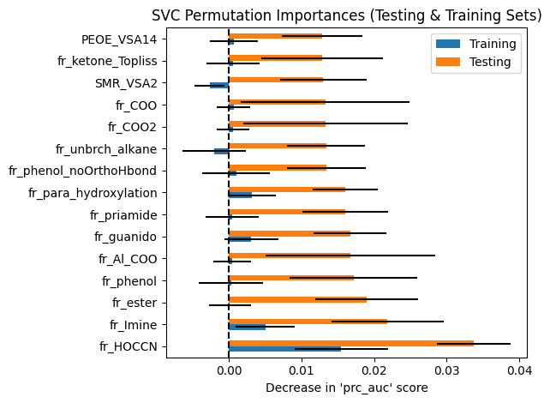
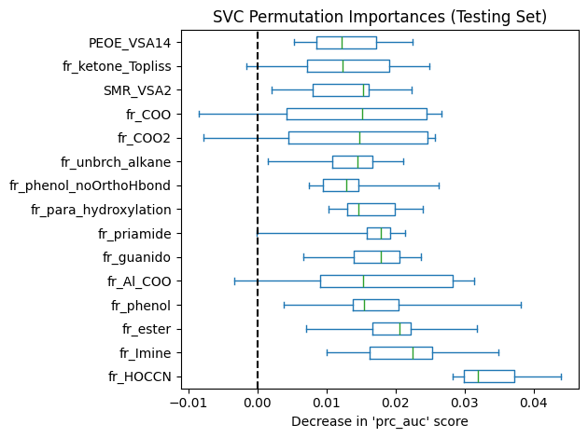
Feature Importance:
1. The Problem: No Coefficients
Unlike Logistic Regression, RBF-SVC does not provide feature coefficients.
Challenge: We cannot mathematically see which features drive the decision directly from the model weights.
2. The Solution: Permutation Importance
We relied entirely on Permutation Importance to interpret the model.
Top Predictor: fr_HOCCN (0.033).
Insight: This fragment is a key driver for the non-linear boundary, a finding invisible to the linear Lasso model.
Top 3 Drivers: fr_HOCCN, fr_Imine, fr_ester.

Slide 25
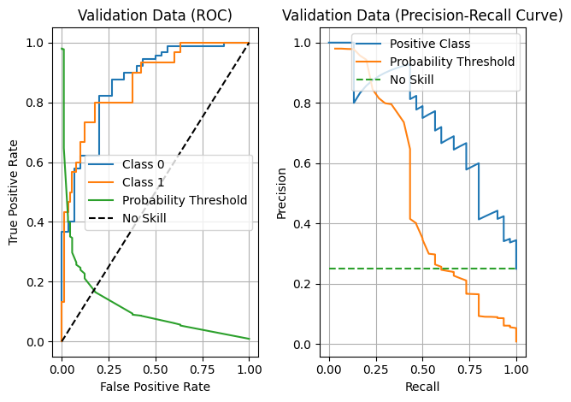
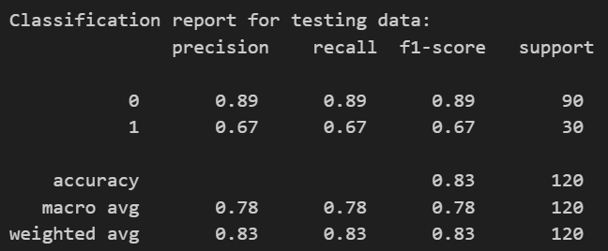
Threshold Tuning:
1. The Optimization
Goal: Balance Precision and Recall for safety.
Best Threshold: Found at ≈0.24 (Lower than default 0.50).
2. Full Model Performance (Test Set)
Recall (Class 1): 67% (Matches best linear model).
Precision (Class 1): 67%.
PR AUC: 0.76 (Very Strong).
3. Takeaway
The tuned Full SVC model offers the best balance of ranking ability (AUC 0.76) seen so far, significantly outperforming the Lasso model's ranking (AUC 0.46).

Slide 26
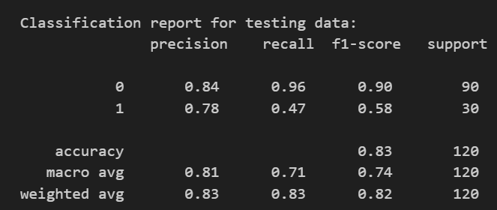
Pruning Analysis:
The Experiment
Action: Removed features with low permutation importance (Reduced to 238 features).
Result: Performance Declined.
The Comparison
Recall: 67% → 47%
PR AUC: 0.76 → 0.73
Precision: Rose to 78%, but at the unacceptable
cost of missing toxic drugs.
Conclusion
"Complexity Matters"
Aggressive pruning broke the subtle interactions between "weak" features needed to maintain the non-linear boundary.

Slide 27
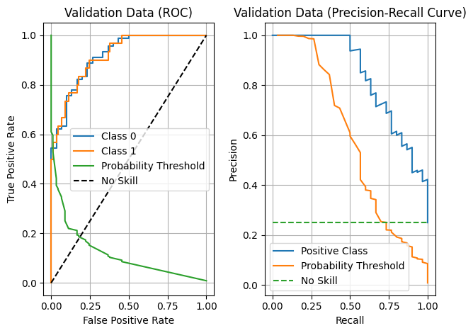
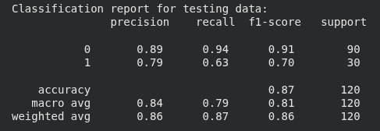
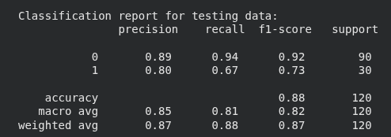
Additional Observations:
1. Performance of simplified model beyond permutation importance feature removal
Optional switch to use ONLY MACCS for model training: Performance was observed to improve for the SVC with RBF kernel – this seems to fall in line with an observation made by related work which noted a particularly good performance of SVC paired with MACCS predictors [8].
2. Full Model Performance (Test Set)
Recall (Class 1): 63%; 67% following further dimensionality reduction by way of removal of zero permutation importance features.
Precision (Class 1): 79%; 80% following further dimensionality reduction by way of removal of zero permutation importance features.
PR AUC: 0.83 (Improved from 0.76 from training on entire dataset).
ROC AUC: 0.92 (Improved from 0.88 from training on entire dataset).
3. Takeaway
Simplified SVC model has improved performance and capability to generalize beyond the training dataset by way of dimensionality reduction (using only MACCS – curse of dimensionality).

Slide 28
Bagged tree Classifier
Model Architecture: Random Subspace Method
1. The Strategy: Diversity via Features
Algorithm: Bagging Classifier (Ensemble of 100 Decision Trees).
2. The "Switch":
We switched off Bootstrapping (bootstrap: False) to use all data rows.
We switched on Feature Subsampling (max_features: 0.7).
Impact: This creates diversity by forcing trees to look at different "Random Subspaces" of chemistry rather than just resampling data rows.

Slide 29
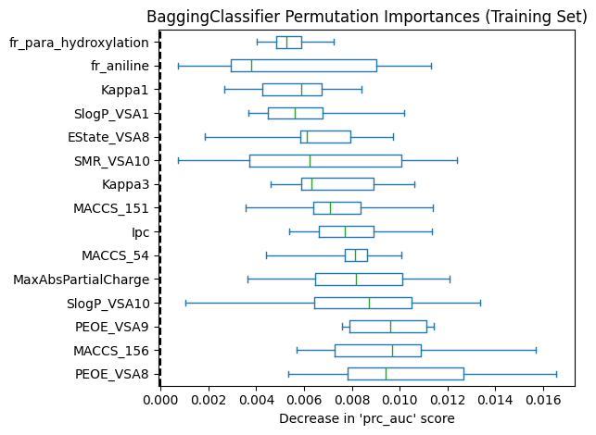
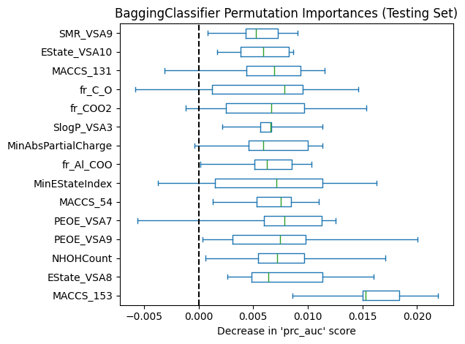
Feature Importance:
1. Model-Specific (MDI)
Metric: Mean Decrease Impurity (Training).
Top Feature: PEOE_VSA8.
Insight: Measures which features structurally reduce entropy in the trees. Good for "memorizing" training data.
2. Model-Agnostic (Permutation)
Metric: Permutation Importance (Test).
Top Feature: MACCS_153.
Insight: Measures actual predictive power. The difference proves that while trees used PEOE to build structure, they relied on MACCS to generalize.

Slide 30
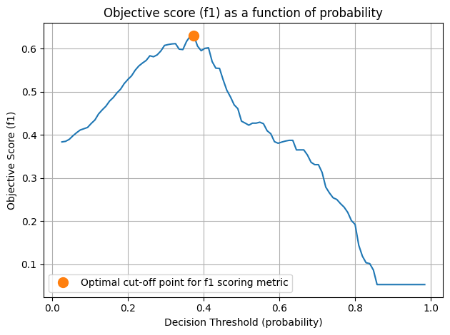
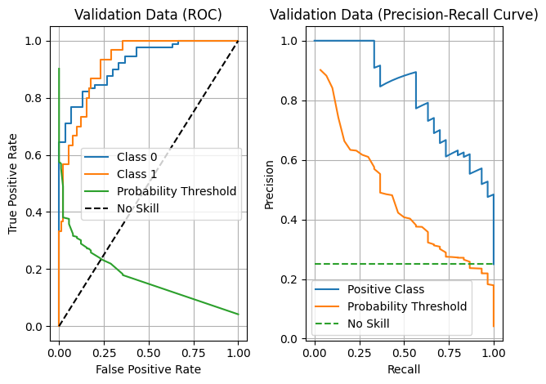
Threshold Tuning
1. The Optimization
Goal: Maximize F1-Score for minority class.
Best Threshold: ≈ 0.37.
2. Full Model Performance (Test Set)
Precision (Class 1): 75%.
Recall (Class 1): 60%.
PR AUC: 0.754.
3. Takeaway
Even before pruning, this ensemble matched the SVC's ranking power, proving that 100 simple trees can rival one complex SVM.

Slide 31
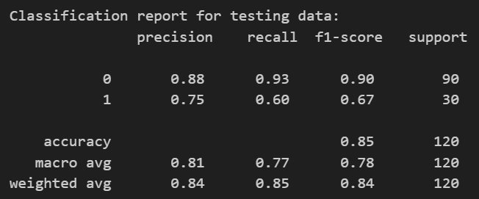
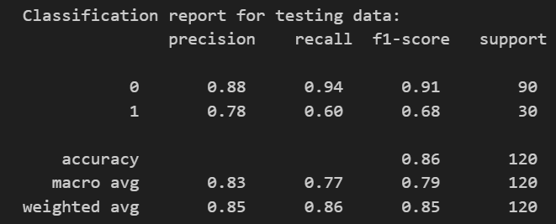
Pruning Analysis
The Experiment
Action: Removed features with non-positive permutation importance.
Result: Massive Improvement.
The Verdict (Test Set)
Precision: 75% → 78%
Recall: Held steady at 60%
PR AUC: 0.75 → 0.814
Conclusion
"Cleaner Consensus"
Since we selected PR AUC as our hyperparameter metric, this jump (0.75 to 0.81) validates the pruning switch.

Slide 32
Random Forest
Model Architecture & Configuration
1. The Strategy: Refined Ensemble
Algorithm: Random Forest (Entropy-based).
Key Difference: Unlike Bagged Trees, Random Forest injects randomness by selecting only a square root (n) subset of features at every node split.
Best Parameters: Criterion: Entropy, Max Depth: 10, Estimators: 100.
2. Performance Baseline (Test Set)
Precision: 67% | Recall: 67%
PR AUC: 0.764
Insight: Matches Bagged Tree and SVC models out-of-the-box, demonstrating high stability without complex tuning.

Slide 33
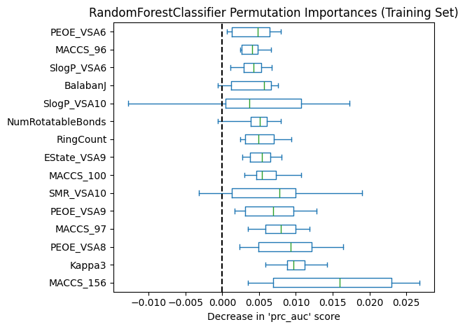
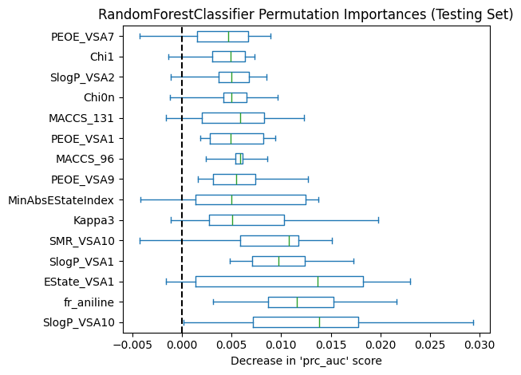
Feature Importance:
1. Internal Metric (Gini/Entropy)
Top Feature: MACCS_156.
Insight: This feature reduces entropy the most during training splits.
2. Permutation Importance (Test Set)
Top Feature: SlogP_VSA10 (Solubility descriptor).
The Disconnect
MACCS_156 was #1 in training but didn't make the top 5 in Test Permutation.
Takeaway: Relying on default importance scores (MDI importance) can be misleading expecially if a dataset includes features with many unique values alongside other features with fewer unique values (entropy bias). Permutation Importance revealed Solubility as the true driver for new drugs.

Slide 34
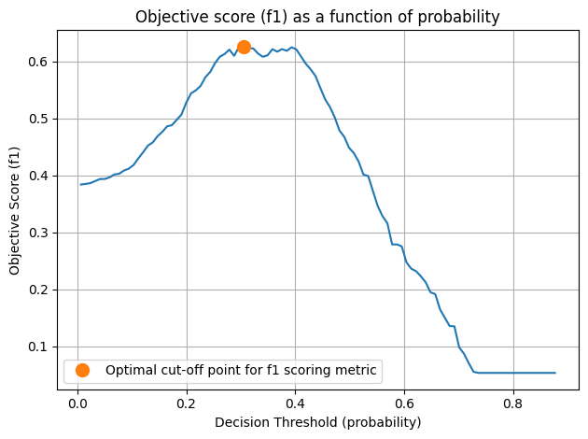
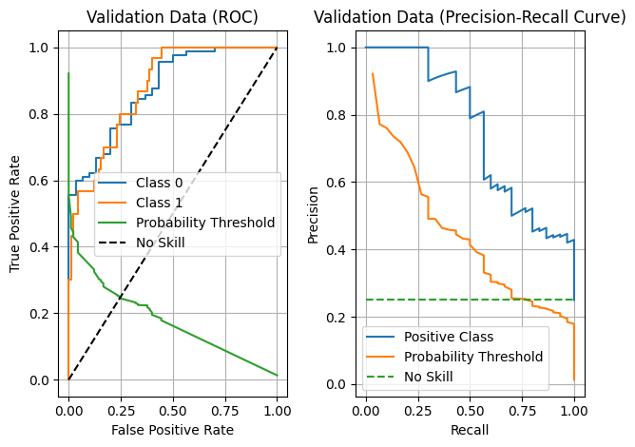
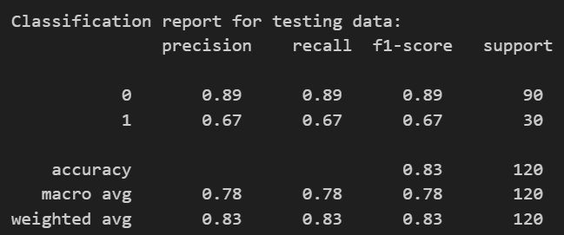
Threshold Tuning
The Optimization
Best Threshold: Found at ≈0.32.
Result: Achieved a perfect balance.
Precision: 67%
Recall: 67%

Slide 35
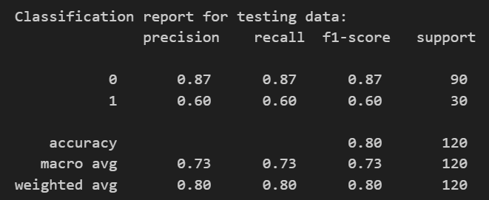
Pruning Analysis
The Experiment
Action: Reduced feature set to 150 based on permutation scores.
Hypothesis: Would it jump in performance like the Bagged Tree model did?
The Verdict
Recall: 67% → 60%
Precision: 67% → 60%
PR AUC: 0.76 → 0.75
Result: Negative.
Conclusion
"The Resilience Theory"
Random Forest naturally filters noise via random selection. Manually pruning removes "backup" features the deep nodes rely on, hurting robustness.

Slide 36
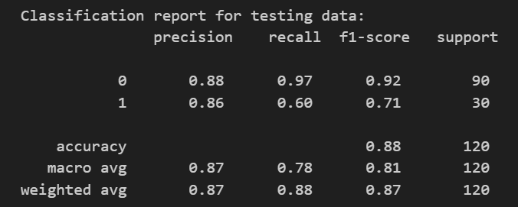
Gradient Boosting
Model Architecture & Configuration
1. The Strategy: Sequential Error Correction
Mechanism: Unlike Random Forest (parallel), GBM builds trees one by one, where each new tree fixes previous errors.
Configuration: Learning Rate 0.01 (Conservative) & Max Depth 10.
Insight: Prioritized "Slow and Steady" to capture complex patterns without overfitting.
2. Performance Baseline (Test Set)
Precision: 86% (Highest of all models).
Recall: 60%.
PR AUC: 0.742.

Slide 37
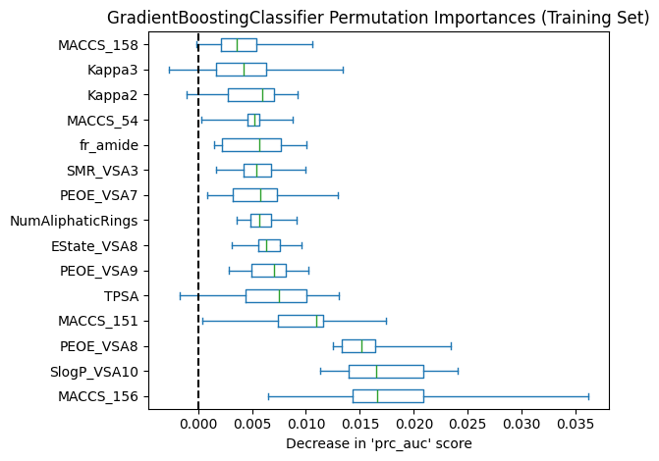
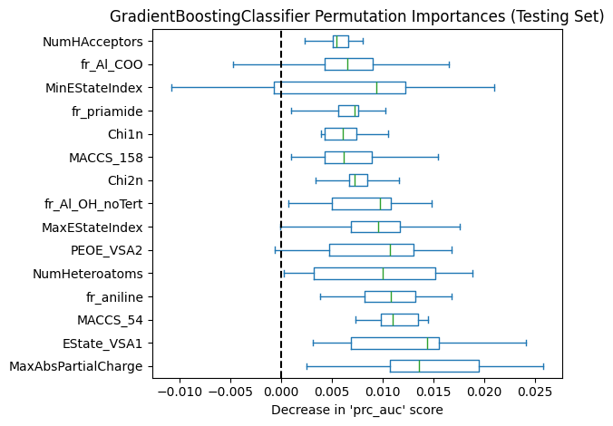
Feature Importance:
1. Internal Metric
Top Feature: SlogP_VSA10 (Solubility).
Insight: Solubility was the primary node splitter during the tree building process.
2. Permutation Importance (Test Set)
Top Feature: MaxAbsPartialCharge.
The Shift: When testing on new drugs, electrical charge distribution became the critical determinant
Takeaway: Solubility structures the trees, but charge determines toxicity in unseen compounds.

Slide 38
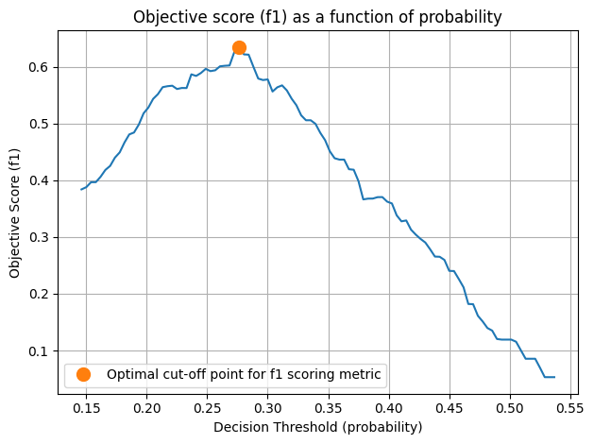
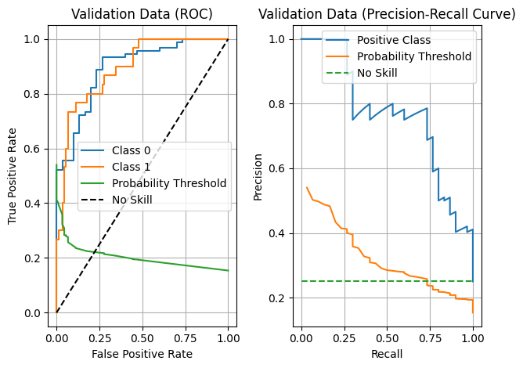
Threshold Tuning
1. The Optimization
Best Threshold: Found at ≈ 0.26.
2. The Result (High Precision Profile)
Precision: 86%.
Recall: 60%.
3. Trade-off Analysis
Unlike other models balancing at 67%/67%, GBM naturally favored Precision.
It is less likely to raise a "False Alarm," making it a high-confidence filter, though it misses slightly more toxic drugs than Bagged Trees.

Slide 39

Pruning Analysis
The Experiment
Action: Pruned feature set to 164 features based on importance scores.
Result: Ranking Improved.
The Verdict
PR AUC: 0.742→0.764
F1-Score: Dropped slightly (0.71→0.68)
due to threshold sensitivity.
The AUC increase proves superior ranking ability.
Conclusion
Validation of Ensemble Theory
Like the Bagged Tree, GBM benefited from removing noise. It confirms that for pure Ensembles, Permutation Pruning is a recommended step.

Slide 40
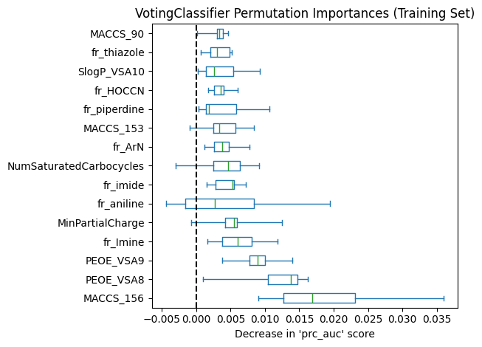
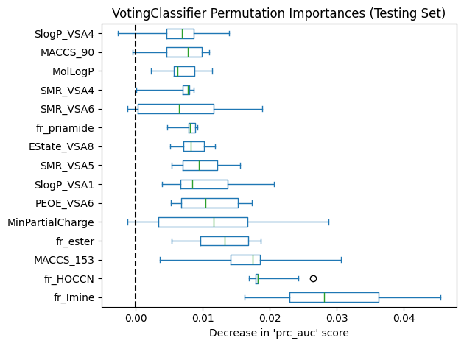
Ensemble Voting Classifier
Model Architecture & Configuration
1. The Strategy: Soft Voting
Mechanism: Combined predictions of all 5 previous models (Logit, SVC, RF, GBM, Bagged).
Why it Wins: It leverages the confidence of specific "experts." If the SVC is 99% sure a drug is toxic based on a complex shape, it can override a weak "safe" vote from the linear models.
2. Training Performance
Accuracy: 100% (Perfect Memorization).
Insight: The ensemble contains powerful non-linear learners (RF/Bagged Trees) that perfectly fit the training data, making Test Set validation crucial.

Slide 41
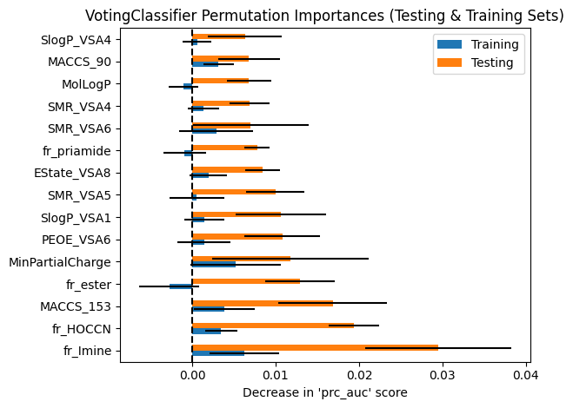
Feature Importance:
1. The "Super-Features"
Top Predictor: fr_Imine (The Linear Favorite).
Second Predictor: fr_HOCCN (The SVC Favorite).
Third Predictor: MACCS_153 (The Tree Favorite).
2. Insight (Generalization)
The Ensemble feature list is a "Greatest Hits" compilation. It automatically correctly identified the strongest signal from each individual algorithm type.
The Benefit: It uses both Structure and Charge, creating a robust safety net.

Slide 42
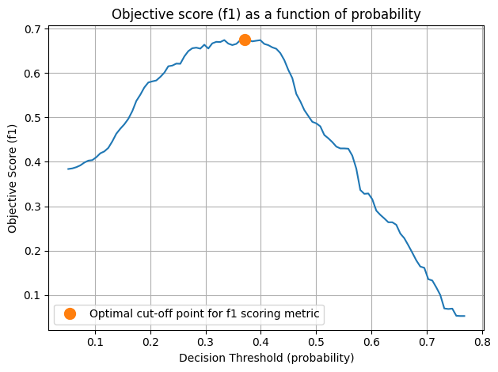
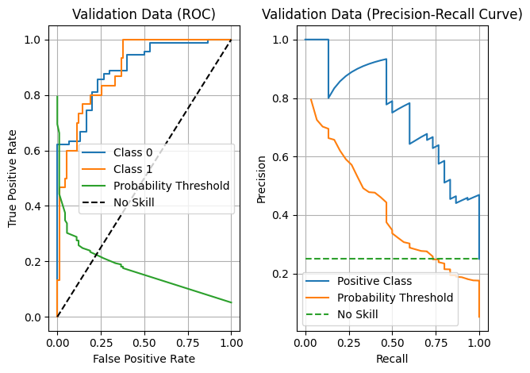
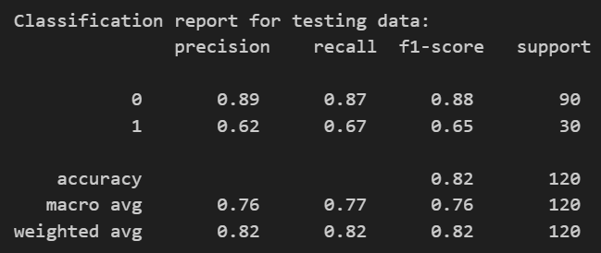
Threshold Tuning
1. The Optimization
Best Threshold: Found at ≈ 0.26.
Goal: Maximize F1-Score for the minority class.
2. Full Model Performance (Test Set)
Recall: 67% (Solid detection).
Precision: 62%.
PR AUC: 0.762.
ROC AUC: ≈0.90 (Excellent Global Discrimination).

Slide 43
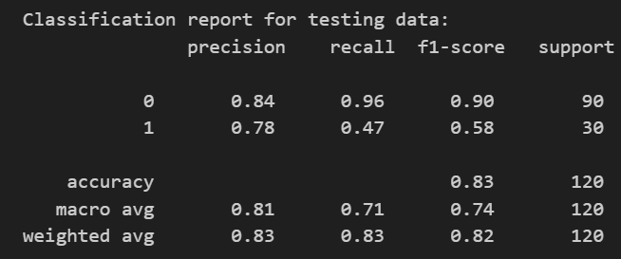
Pruning Analysis
The Experiment
Action: Pruned feature set to 160 features.
Hypothesis: Would removing noise help the committee vote?
The Verdict
Recall: Crashed (67→47%).
Precision: Rose to 78%, but at the cost of safety.
PR AUC: Dipped slightly (0.76→0.75).
Conclusion
"Diversity Requires Data"
Pruning "blinded" some committee members (SVC/RF), causing the model to miss complex toxic drugs.
The Full Ensemble is superior.

Slide 44
Conclusions and Post-Classification Analyss

Slide 45
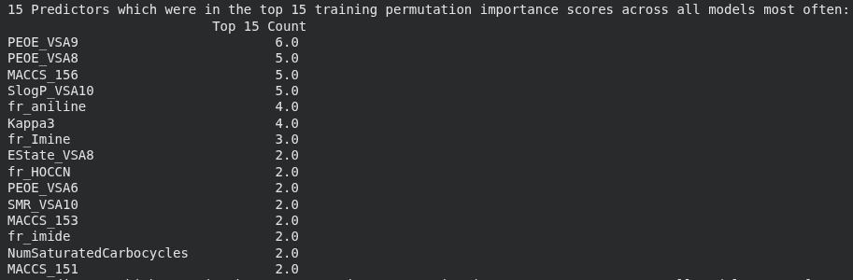
Predictors Scoring in Top Permutation in Training Cross-Validation (K=3)
Observation: PEOE_VSA, SlogP_VSA, type molecular descriptors appear to have dominated as most important for training and generalizing the model for predicting unseen data
MACCS_156 (bit position 156) is also observed to have had high importance across models, an observation made in other prior work as well (Molecular Fingerprint-Based Machine Learning Model development for biodegradability prediction) [8].

Slide 46
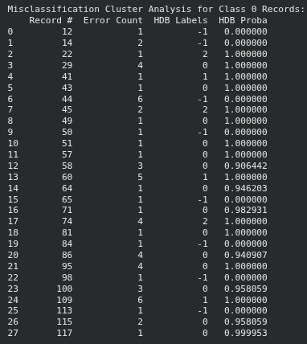
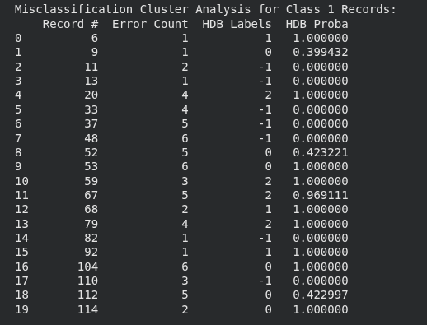
Analysis of Misclassified Records
Observation: Results of applying HDBSCAN to misclassified records from DIA-positive and DIA-negative samples seemed to show most frequently misclassified records tending to be clustered together – this confirmed expectations that such records may have certain disctinct characteristics that set them apart from "normal" records

Slide 47
Features that consistently ranked high in Permutation Importance
fr_Imine: Ranked as a top predictor in the Voting Ensemble (testing set and top 15 for training), Logistic Regression (testing set and top 15 for training), and SVC (#2 for testing, top 15 training). This is the strongest linear predictor.
fr_aniline: Consistently in the Top 5 for Logistic Regression, Random Forest, and Gradient Boosting.
PEOE_VSA... (Molecular Surface Area/Surface Charge Descriptors): Specifically PEOE_VSA8, PEOE_VSA9, and PEOE_VSA6. These appeared in the Top 15 for almost every model (Linear and Tree-based).
MACCS[156] (MACCS_157): A specific substructure key that appeared in the Top 3 for Logistic Regression, Random Forest, and Gradient Boosting.
SlogP_VSA10 (Molecular Surface Area Descriptor): The top predictor for lipophilicity (fat solubility), ranking highly in all tree-based models (RF, GBM, Bagged Trees).

Slide 48
Features that consistently scored zero
Initial Zero-Variance Feature Removal: Initial data preprocessing stage removed 34 specific features. These features would have been hurtful for computation costs and may have even presented issues for model training.
Permutation Analysis: Features with negative or zero importance were predominantly "noise" features—random molecular descriptors that provided no predictive value.
Pattern: Roughly ~50% of the 300+ features contributed little to no signal, which is why feature reduction (dropping from ~360 to ~150 features) was possible without collapsing the models.

Slide 49
Whether removing zero-importance features changed accuracy
The Verdict: Removing features generally hurt accuracy slightly but improved model (AUC) performance in some cases.
Specifics:
Logistic Regression: Improved Performance. Test Accuracy maintained and recall rose from 0.57 → 0.67 for the minority DIA positive class. (Simpler model generalized better from training to testing set).
Random Forest: Slight Drop. Test Accuracy fell from 0.83 → 0.80.
Gradient Boosting: Minimal Drop. Test Accuracy fell from 0.875 → 0.86.
Bagged Trees: Improvement. Test Accuracy increased/held at 0.86, but ROC AUC jumped significantly (0.88 → 0.92).
Takeaway: Pruning features helped the Bagged Tree generalize better (less overfitting) in addition to helping the Logistic Regression.

Slide 50
Records that multiple models misclassified (The "Hard" Cases)
The Pattern: There is a core group of drugs that are "universally hard" to predict. They likely represent a different mechanism of toxicity or are "activity cliffs" (structurally similar to safe drugs but toxic).
The "False Negative" Cluster (Toxic drugs predicted as Safe):
Records #48, #53, #104: Misclassified by ALL 6 models.
Records #37, #67, #112: Misclassified by 5 models.
Observation: HDBSCAN showed these often clustered together (e.g., in Cluster 2), suggesting they share specific chemical properties that confuse the models.
The "False Positive" Cluster (Safe drugs predicted as Toxic):
Records #44, #109: Misclassified by ALL 6 models.
Record #60: Misclassified by 5 models.

Slide 51
Final Thoughts
Final Answer to Research Question: "Which molecular features are most important for predicting DIA?"
"The prediction of Drug-Induced Autoimmunity is driven by a dual-signal mechanism:
Reactive Metabolite Formation: The presence of specific structural alerts—specifically Anilines and Imines—is the strongest risk factor. These fragments differ from stable drugs because they are metabolically activated into reactive species that bind to human proteins.
Electrostatic Binding Interactions: Beyond specific fragments, the drug's surface charge distribution (PEOE_VSA descriptors) and lipophilicity (SlogP) determine its ability to access and bind to immune receptors (like HLA proteins). A drug must occupy a specific 'Goldilocks zone' of solubility and electronic charge to trigger an autoimmune response."

Slide 52
Future Work
Further clustering analysis
We analyzed misclassified records for patterns, but not necessarily which molecular descriptors were contributing to said patterns (score of project was mostly focused on identifying important predictors)
Further work with other methods of feature selection and importance evaluation
Used "all or nothing" approach of removing all zero permutation importance importance for reevaluating model performance; could employ other methods such as "drop-column importance" (Iterate through features and for each feature in the dataset, drop the feature, retrain the model, measure performance)
Additional analysis with respect to Voting Classifier/Ensemble approach
Potentially not use all models (i.e. eliminate weakest link/Logistic Regression and reevaluate performance)
Different Bagging Classifiers -> ensemble of SVC paired with MACCS predictors
Additional investigation of other structural/molecular fingerprints as predictors
MACCS observed to have paired very well with SVC to improve performance; potenially other fingerprint types (i.e. Morgan) would have similar effects with other classifier types

Slide 53
Appendix
Added since initial presentation:
Additional switches for optional binning of numerical variables and file path configurations
Now considers standard deviation in permutation importance
Only removes features with zero (or negative) mean AND zero standard deviation permutation importance

Slide 54
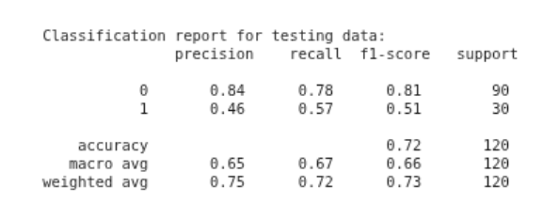
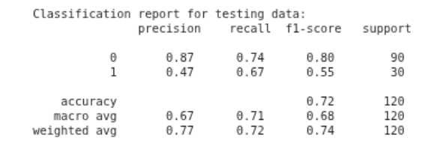
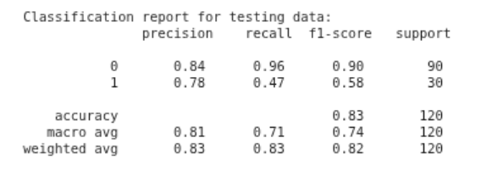

Appendix
Impact of binning of numerical predictors (3 bins with uniform widths) & removal of zero (or negative) mean AND zero standard deviation permutation importance features change before -> after
Logistic Model:
RBF-SVM:

Slide 55




Appendix
Impact of binning of numerical predictors (3 bins with uniform widths) & removal of zero (or negative) mean AND zero standard deviation permutation importance features change before -> after
Random Forest:
GBM performance:

Slide 56


Appendix
Impact of permutation importance change before -> after
Bagged Tree Classifier:
Overall, this change only made a small difference
Notable improvement to class-1 in RBF-SVM

Slide 57
References
[1] “5.2. permutation feature importance,” scikit-learn, https://scikit-learn.org/stable/modules/permutation_importance.html (accessed Dec. 1, 2025).
[2] André Altmann, Laura Toloşi, Oliver Sander, Thomas Lengauer, Permutation importance: a corrected feature importance measure, Bioinformatics, Volume 26, Issue 10, May 2010, Pages 1340–1347, https://doi.org/10.1093/bioinformatics/btq134
[3] “Precision-recall,” scikit-learn, https://scikit-learn.org/stable/auto_examples/model_selection/plot_precision_recall.html#sphx-glr-auto-examples-model-selection-plot-precision-recall-py (accessed Dec. 2, 2025).
[4] J. Davis, The relationship between precision-recall and ROC curves, https://ftp.cs.wisc.edu/machine-learning/shavlik-group/davis.icml06.pdf (accessed Dec. 2, 2025).
[5] T. Saito and M. Rehmsmeier, “The precision-recall plot is more informative than the ROC plot when evaluating binary classifiers on imbalanced datasets,” PLOS ONE, https://journals.plos.org/plosone/article?id=10.1371%2Fjournal.pone.0118432#sec026 (accessed Dec. 2, 2025).
[6] Wu Y, Zhu J, Fu P, Tong W, Hong H, Chen M. Machine Learning for Predicting Risk of Drug-Induced Autoimmune Diseases by Structural Alerts and Daily Dose. Int J Environ Res Public Health. 2021;18(13):7139. Published 2021 Jul 3. doi:10.3390/ijerph18137139
[7] Lina Huang, Peineng Liu, Xiaojie Huang, InterDIA: Interpretable prediction of drug-induced autoimmunity through ensemble machine learning approaches, Toxicology, Volume 511, 2025, 154064, ISSN 0300-483X, https://doi.org/10.1016/j.tox.2025.154064.
[8] Elsayad, Alaa & Zeghid, Medien & Ahmed, Hassan & Elsayad, Khaled. (2024). Prediction of Chemical Compounds Biodegradability: Molecular Fingerprint-Based Machine Learning Models. IEEE Access. PP. 1-1. 10.1109/ACCESS.2024.3461164.

